Slide 1
A Summary of IST 402
(Week 14)
Emma Dodoo, Grace Morgan, Sarah Dragon, Andrew Witherite

Slide 2
AI and Multiagent Systems for Social Good
Public Safety and Security
Conservation
Public Health
KEY CHALLENGE
How can we optimize our limited intervention resources when we are interacting with other agents?

Slide 3
Optimizing Limited Intervention Resources
Public Safety and Security
Game Theory for Security Resources Optimization
Real-world: US Coast Guard, US Federal Air Marshals Service
i.e. African Countries: Ghana, Uganda
Public Safety and Conservation
Security games and adversary
Green security games
Intelligent patrol patterns
Real-world: Parks
i.e. Zambia, Mozambique
PAWS
Increased hit rate on poachers and related items to 3 from .73

Slide 4
Solving These Problems: Overall Research Process
1. Immersion
data collection
2.Predictive model
learning/expert input
3.Prescriptive algorithm
game theory intervention
4.Field tests
deployment

Slide 5
Game Theory: Security Resource Optimization
Based on Stackelberg Security Game
Stackelberg Example: Defender commits to randomized strategy, adversary responds
shows a strategy and game can be as complex as you want
For simplicity, numbers are determined by surveillance, etc.
Optimization: Not 100% security (i.e defender would always win), increase cost/uncertainty to attackers
Can’t guarantee 100% security due to limited resources
Real-World: ARMOR at LAX [2007], IRIS for Federal Air Marshals Service [2009]
Defender | Adversary
 |  | Terminal #1 | Terminal #2
 | Terminal #1 | 4, -3 | -1,1
 | Terminal #2 | -5, 5 | 2, -1

Slide 6
Why don’t Countries use Machine Learning?
We simply do not have enough data
A lot of countries simply do not have frequent breaches, to gather datasets of information

Slide 7
Class Recap

Slide 8
Key Takeaways
AI has blossomed into one of the biggest fields in computer science
Led by AI and ML
More data - big data
Better computing power

Slide 9
AI Trajectory: Valid Concerns
People: Elon Musk, Bill Gates, Stephen Hawking
Fake news generator (recently been released)
AI Chatbot that was discovered to be racist
Facebook tagged two people as gorillas among AI discrimination issues
AI Discrimination amongst employee hires

Slide 10
But...
Despite these issues, AI still has enormous potential to help underserved people
Course has been exercise in making you believe in vision
Numerous applications of how humanity can be helped through the use of AI

Slide 11
What cool techniques did we learn?
Train, validation, test (supervised learning)
Training set is a set of examples used for learning a model
Validation set is a set of examples that cannot be used for learning the model but can help tune model parameters
Need a validation set to figure out what parameters should be used in your model
Helps control overfitting
Test set is used to assess the performance of the final model and provide an estimation of the test error
Results on the testing set are the only results that matter for final product
NOTE: Never use the test set in any way to further tune the parameter or revise the model
Decision Trees

Slide 12
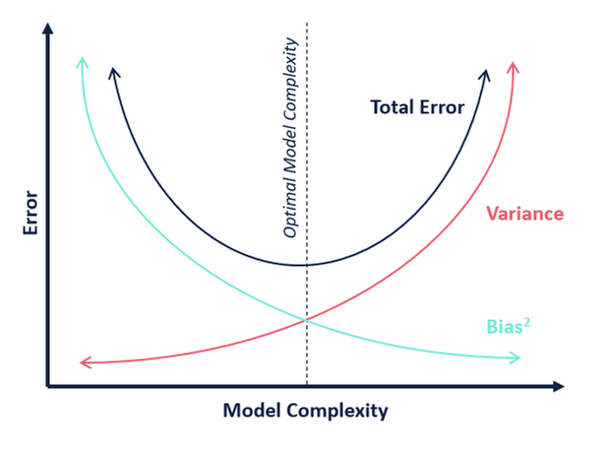
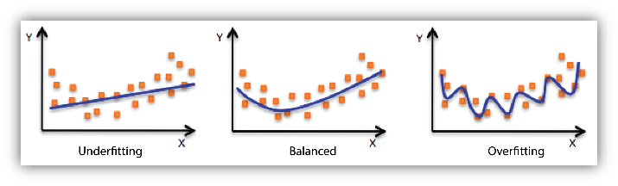
Training and Testing
Underfitting - High bias
Overfitting - High variance
Bias Variance Tradeoff

Slide 13
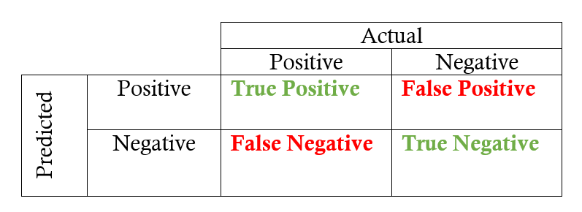
Evaluation Metrics
Predicted labels
2 options: Positive or Negative
The predictive and the actual labels can be either positive or negative

Slide 14
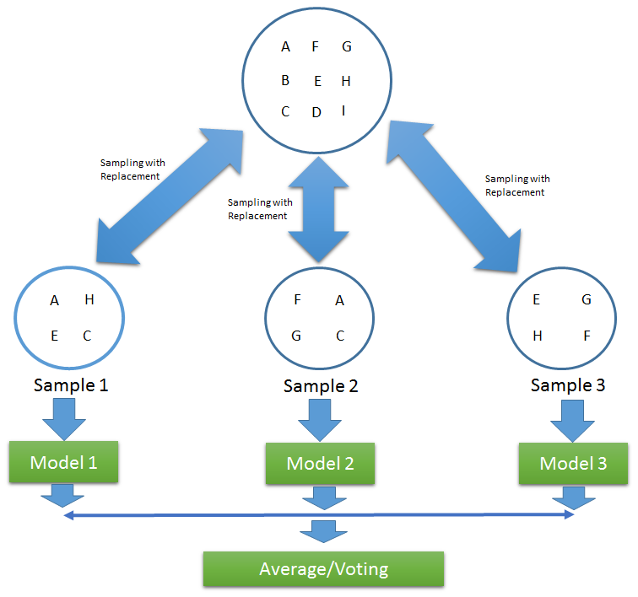
Bagging
More evolved version of a decision tree
Essentially create multiple decision trees
After making all the decision trees, the decision that you will make will be the average of all the decision trees
Use an average model as the final model

Slide 15
Prisoner’s Dilemma
Rational way of solving: it is always optimal to defect
In rational play, both players will choose to defect
Confess Lie
Confess
Lie
1 month, 1 month | 3 years, Free
Free, 3 years | 1 year, 1 year

Slide 16
Nash Equilibrium
It is suboptimal for each player to deviate from their strategies, if the other play continues to play the same strategy
Given they are at equilibrium
Every finite game has a nash equilibrium

Slide 17
Stackelberg Game: Non-simultaneous moves
One player is a defender - They move first
Must commit to random strategy
Other player is the adversary - They move after the leader
Responds to random strategy
Not 100% security - optimizing chances based on limited resources

Slide 18
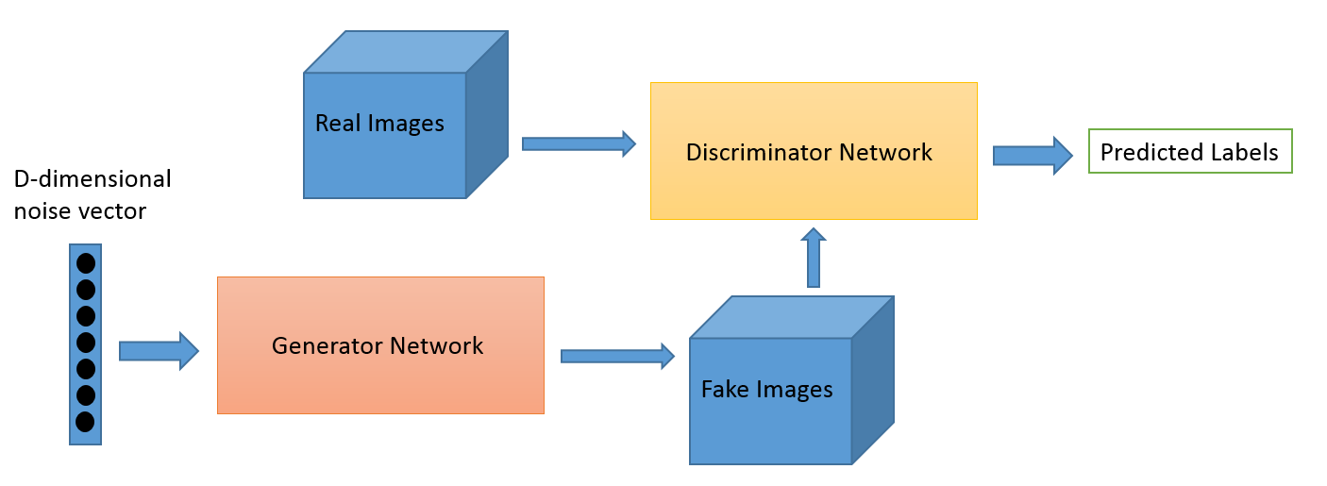
Deep Learning
Neural Networks
Backpropagation algorithm
Different kinds of Neural Networks
Vanilla deep nets - numeric data
Convolutional neural networks (CNN) - image data
Generative adversarial nets (GAN) - create data
Recurrent neural nets (RNN) - sequentially structured data (text, videos,etc.)
GAN

Slide 19
More than Accuracy...
Interpretability - Medical community
Fairness - COMPAS
Ethics - Self-driving cars
Machine application for social good - predicting childhood influenza

